Slide 1
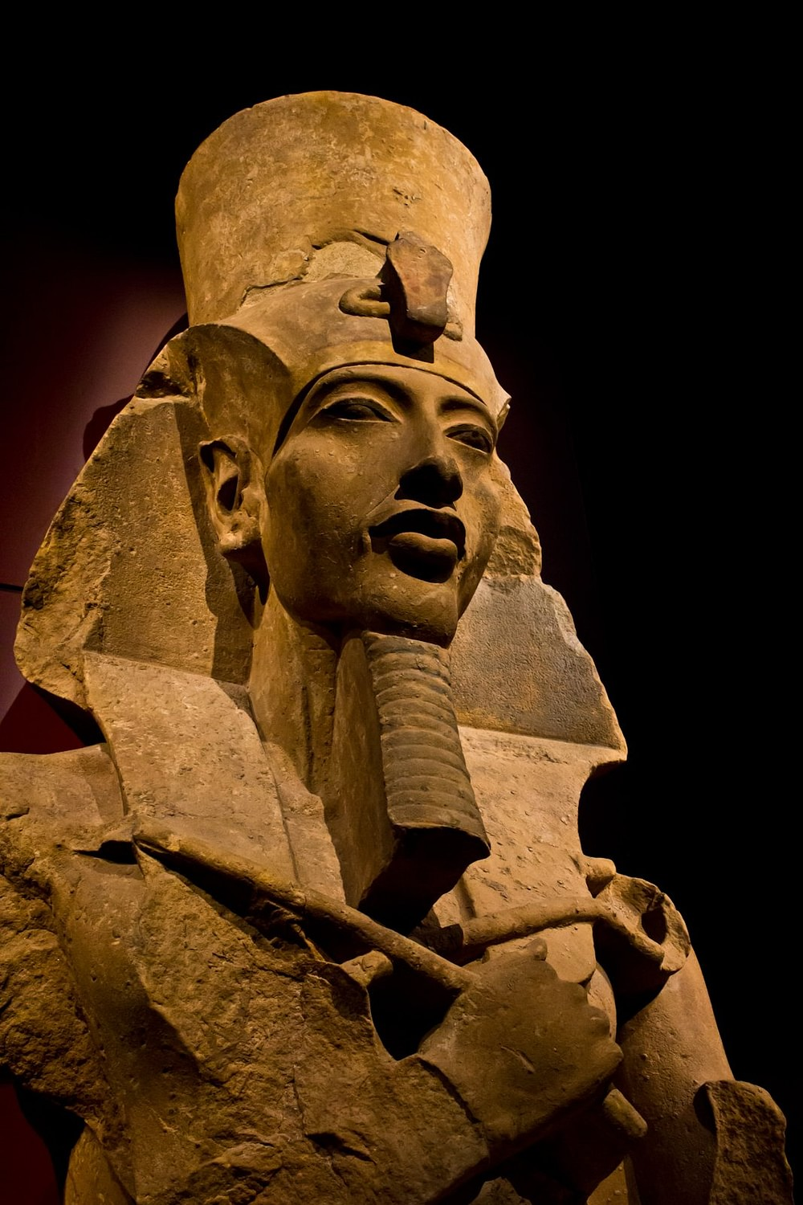
Key People and Periods
GOAL/S: Identify key people
Outline the key time periods
Week 8, Lesson 2

Slide 2
Today’s Lesson:
Ancient People (during our period of study)
Key Events (Timeline/Chronology of our period of study)

Slide 3
ACTIVITY 1 – Ancient People
Each student will receive a worksheet
Cut this out, and glue it in your book
Each group will receive ONE (1) key person
You will have 2 minutes to read through the information about this person, and summarise it on your worksheet

Slide 4

ACTIVITY 2 – Ancient Timeline
Use the KEY DATES provided to fill in a timeline of Ancient Egypt (use the framework OR create your own)

